Slide 1
Briefing about the
Youth Leadership Training
“Civic participation and engagement of Youth”
23-25 November 2016
Paro College of Education

Slide 2
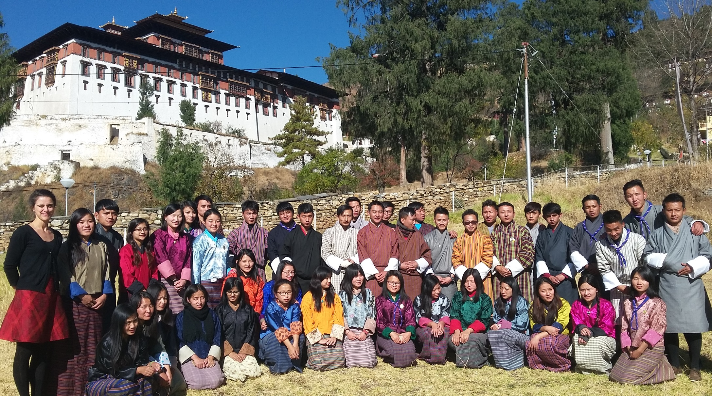
43 young women and men
– ready to lead Bhutan…

Slide 3
Aims and Objectives of the Training:
To provide youth with a space/platform to act for social change
To provide the youth with active citizen skills
To equip the youth with skills to support other youth members in their community.

Slide 4
The training feeding in to the project
The project’s overall objective:
Promote democracy, citizenship, and democratic understanding among youth of Bhutan through strengthening youth involvement in civil society
The project’s 4 expected results:
Increase public democratic discourse among youth: More than 300 young people are actively engaged in public democratic discourse and media.
Increase active citizenship and leadership among youth: More than 300 young people are engaged as active citizens and youth leaders in civil society.
3. Vibrant media lab and media clubs: More than 300 youth are regularly engaged in activities of the media lab and media clubs related to democratic citizenship, government engagement and amplification of youth’s voice.
4. Enhanced capacity of Bhutan Centre for Media and Democracy: 5 BCMD staff and 15 youth leaders promote democracy, democratic understanding and citizenship among youth.

Slide 5
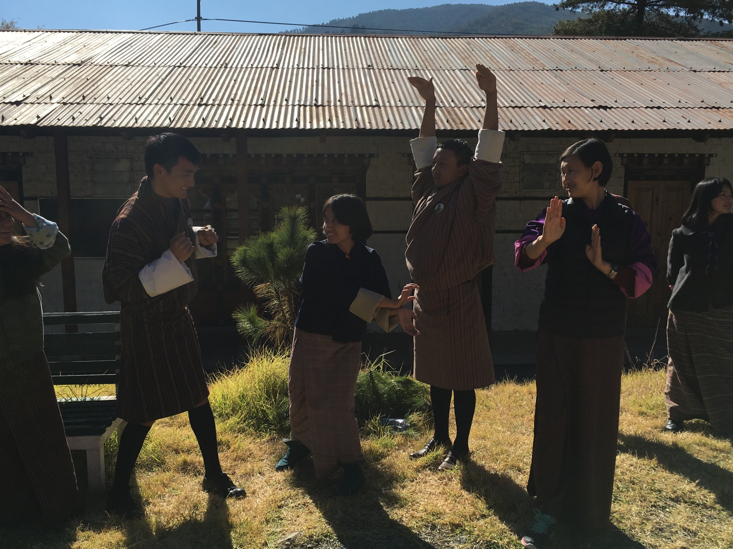
SOME PICTURES FROM THE ACTIVITIES

Slide 6
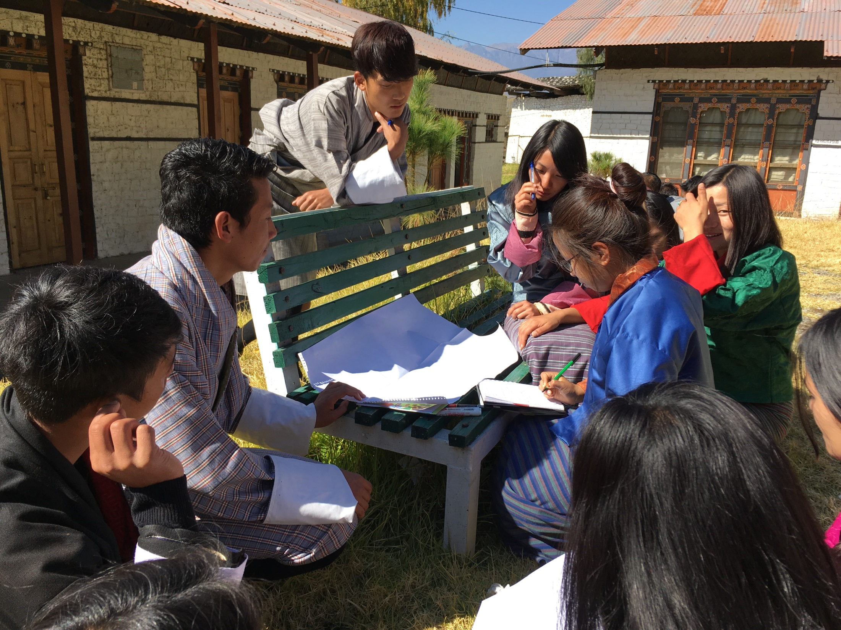
PREPARING A SWOT ANALYSIS OF THEIR YOUTH GROUPS

Slide 7
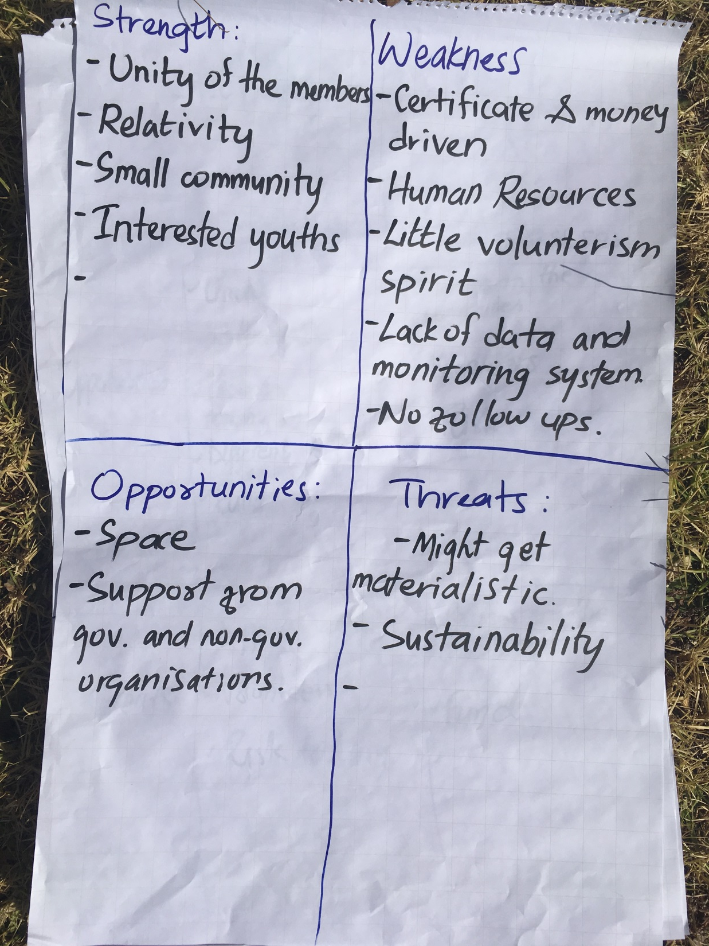
REAFFIRMS THE PROJECT’S LOGIC – that there is a need to strenghten youth leadership as well as youth platforms

Slide 8
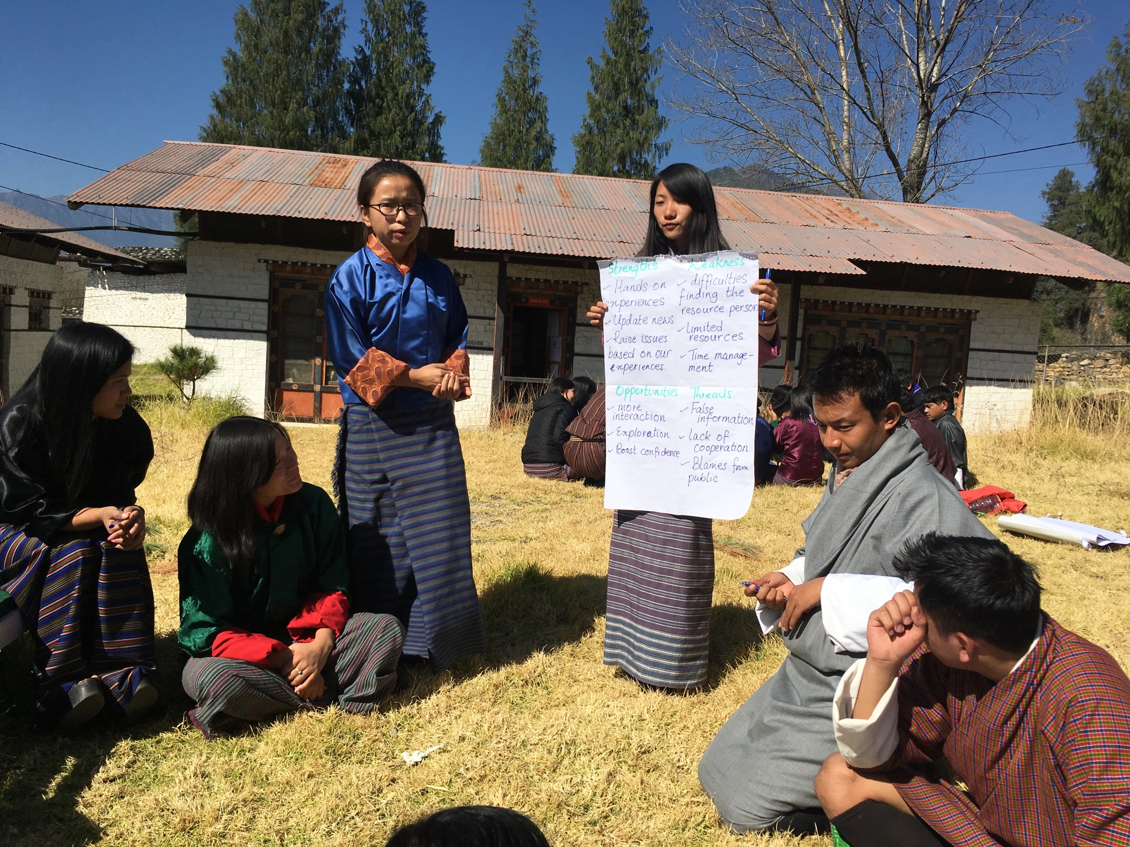
PRESENTATIONS – GIVING EVERYONE A CHANCE TO SPEAK

Slide 9
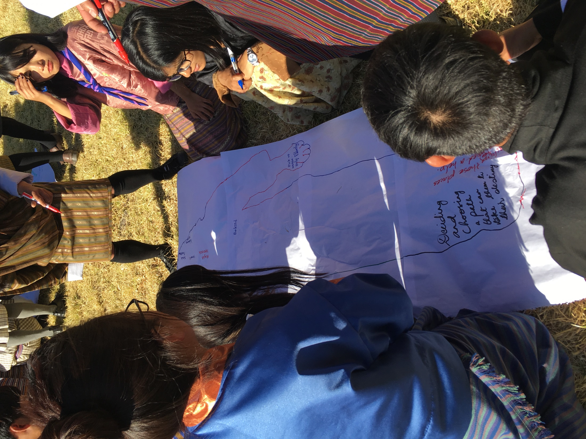
THE BODY MAP – WHAT IS A YOUNG PERSON IN BHUTAN?

Slide 10
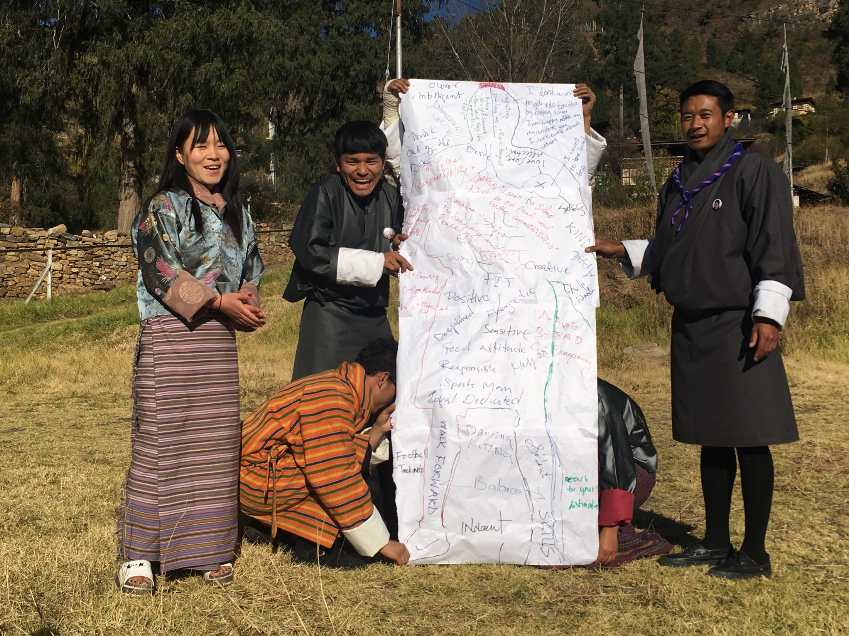

Slide 11
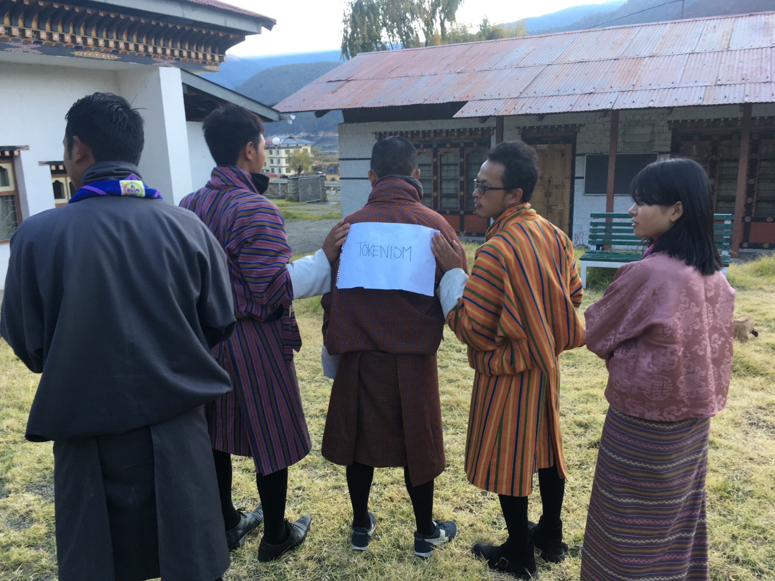
ROLE PLAY ABOUT THE YOUTH PARTICIPATION LATTER – are youth really participating in decision making?

Slide 12
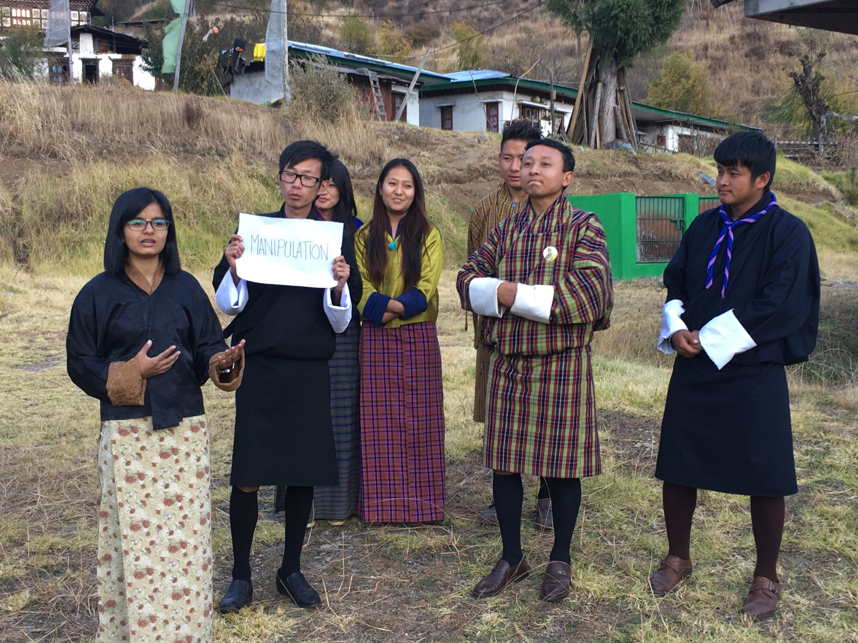

Slide 13
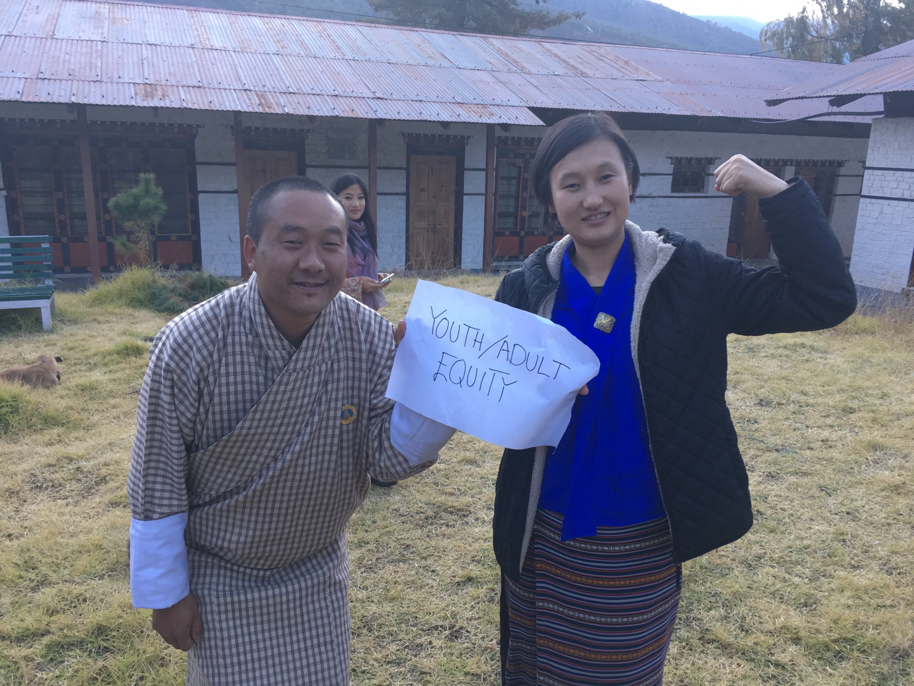
BCMD TEAM and CO-FACILITATORS: THINLEY AND PHUNTSO

Slide 14
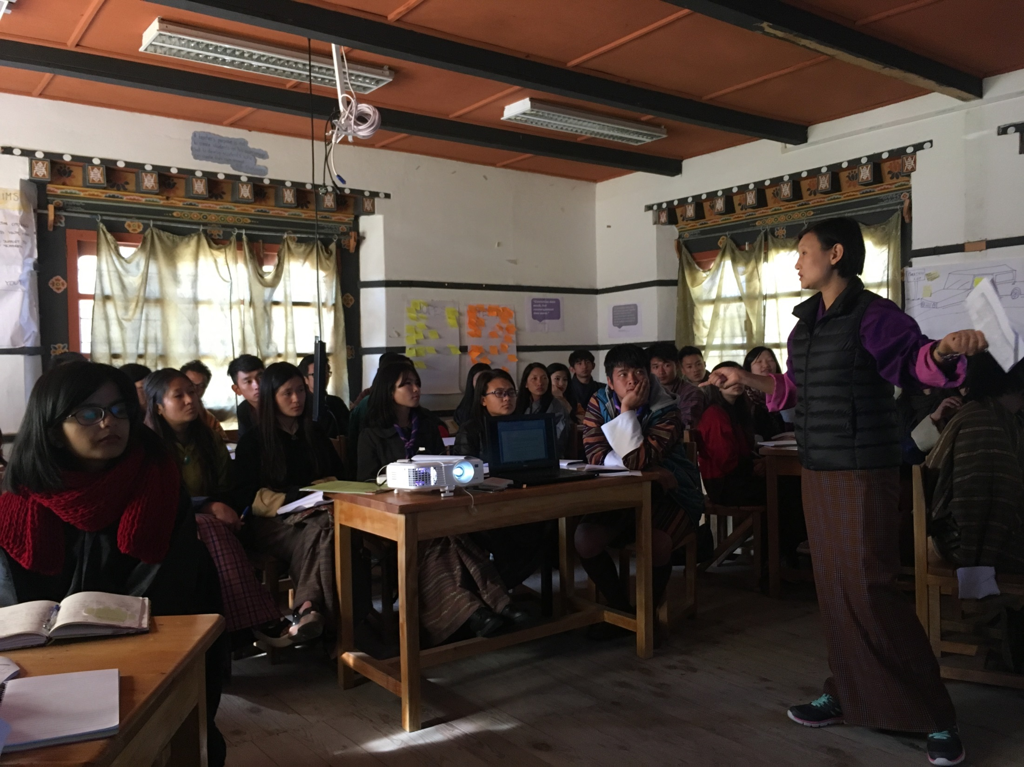
BCMD TEAM and CO-FACILITATORS: TAKING MORE AND MORE OVER….

Slide 15
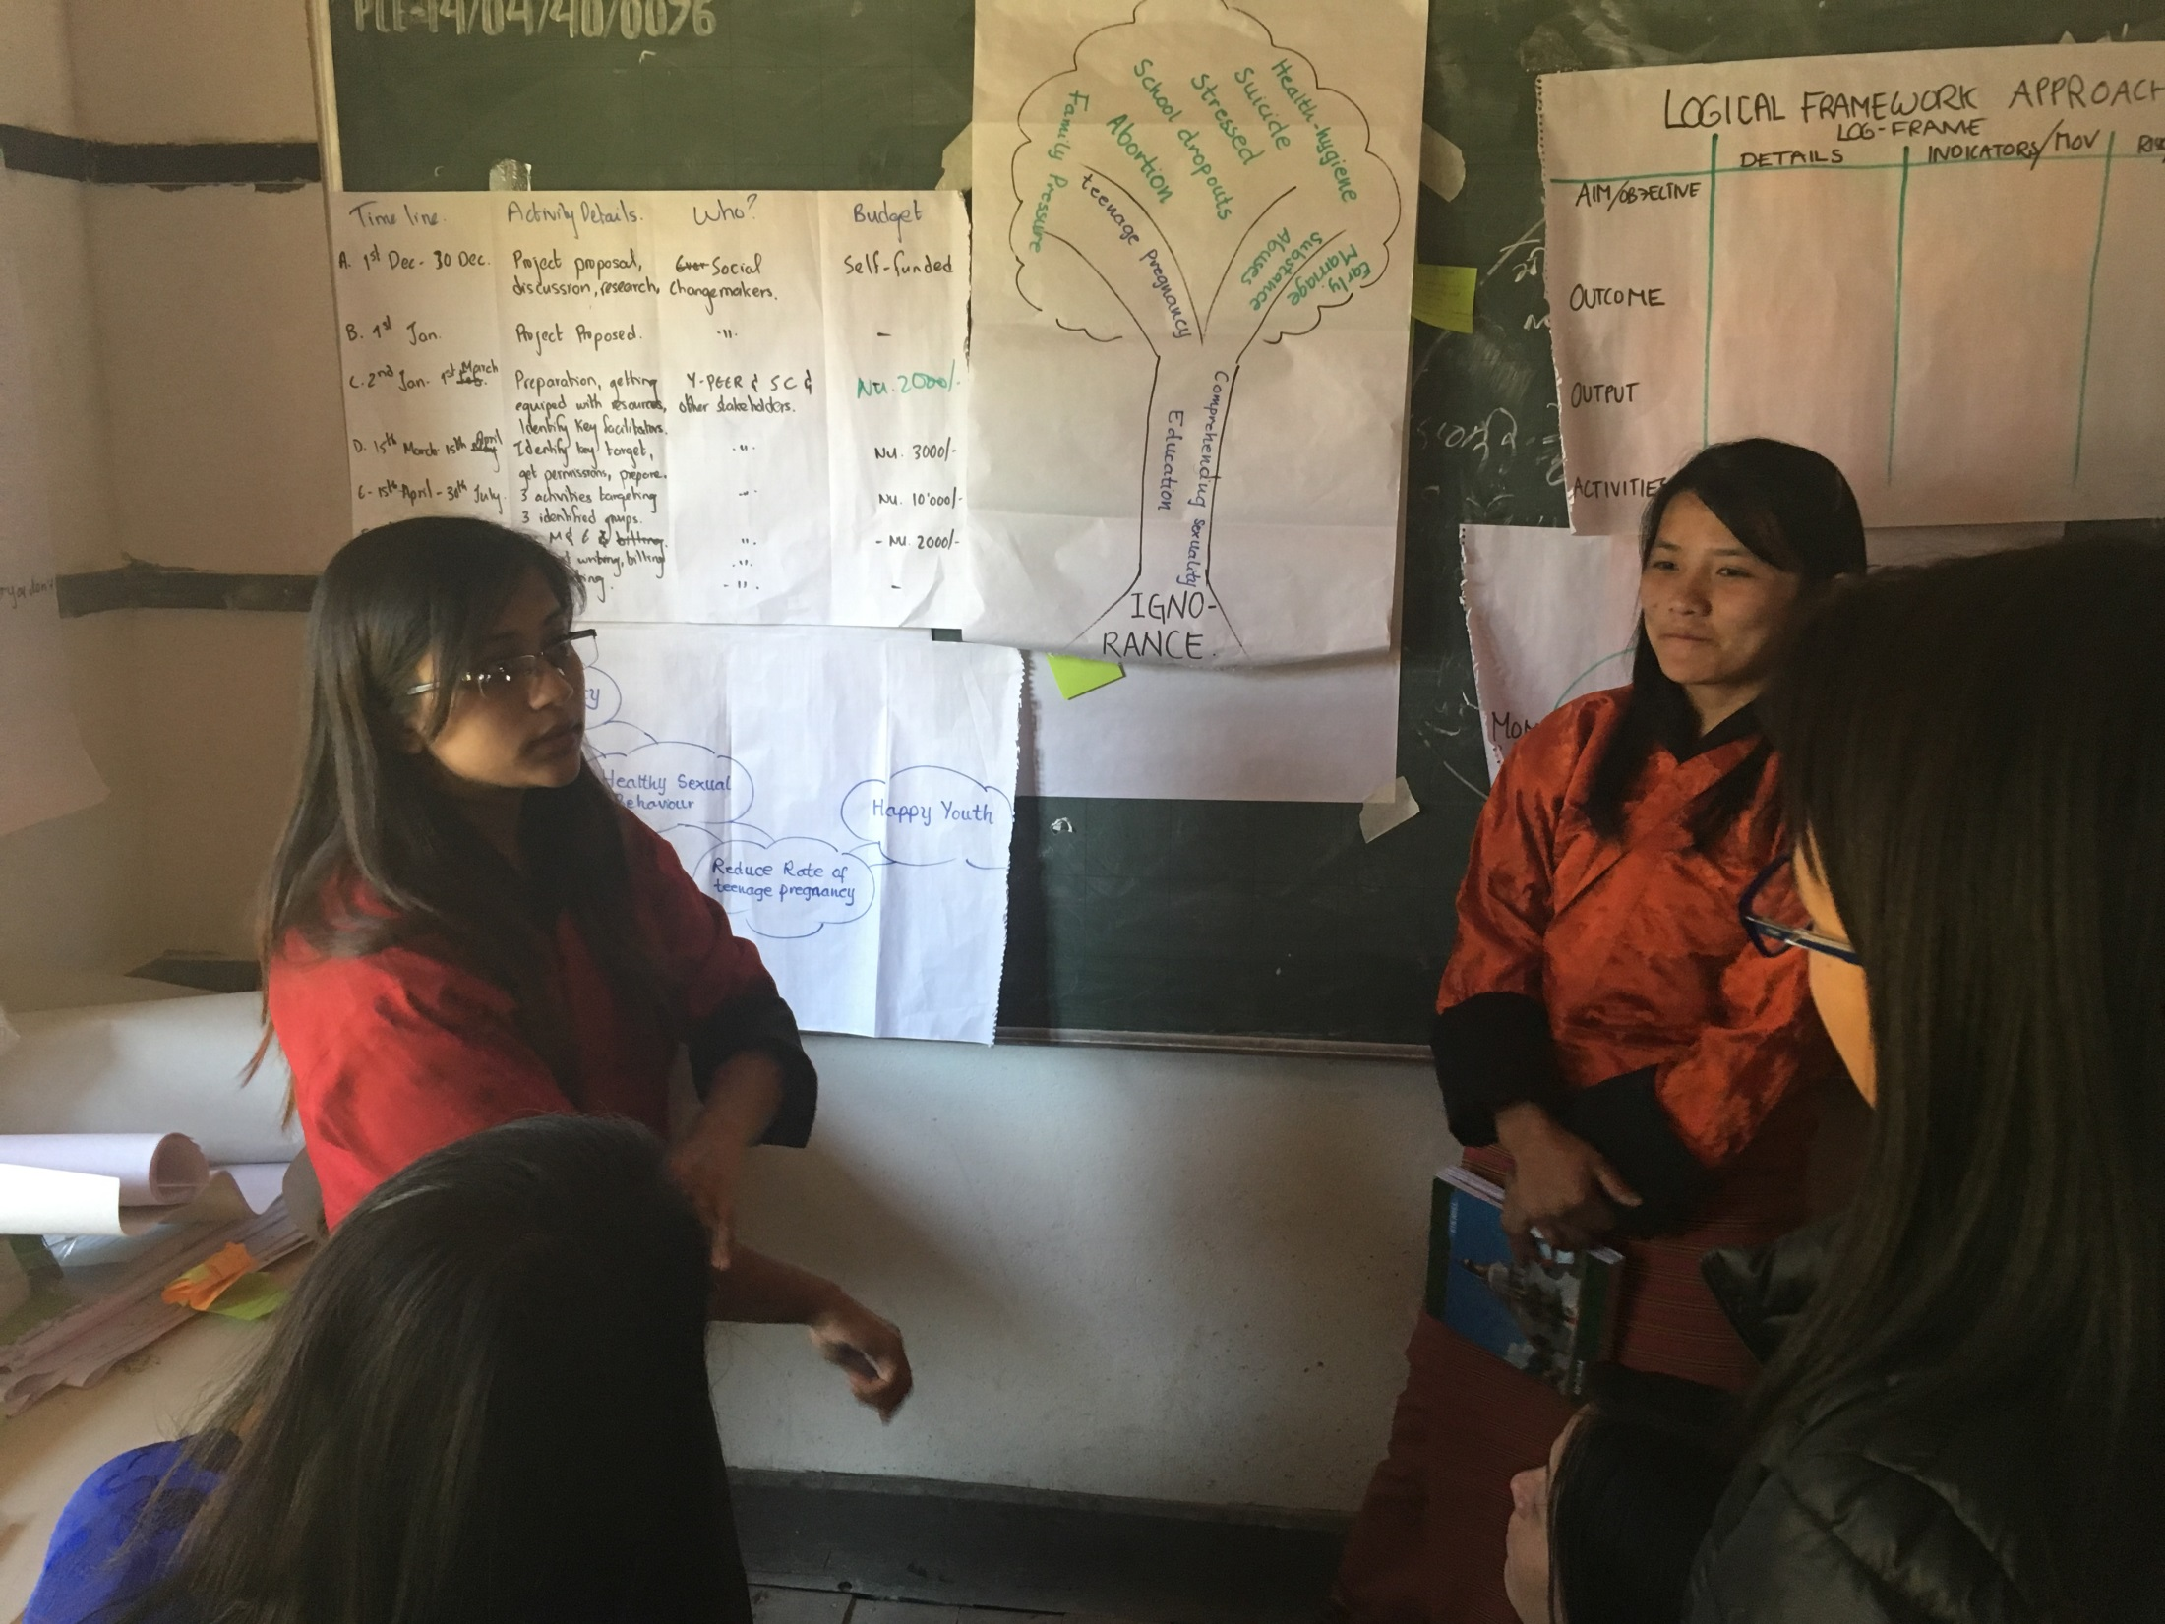
DESIGNING YOUTH-LED PROJECTS – PROBLEM TREE, LOG-FRAME AND PROJECT PLANS

Slide 16
RESULTS from BCMD’s evaluation:
At the end of the training, participants expressed about the leadership qualities and tools they acquired.
Participants were able to work on 6 seed fund proposals to improve the social situation in their communities.
Participants had the opportunity to interact and discuss about social work.
Youths from different backgrounds such as LGBT+ Bhutan, recovered addicts, scouts and others were included

Slide 17
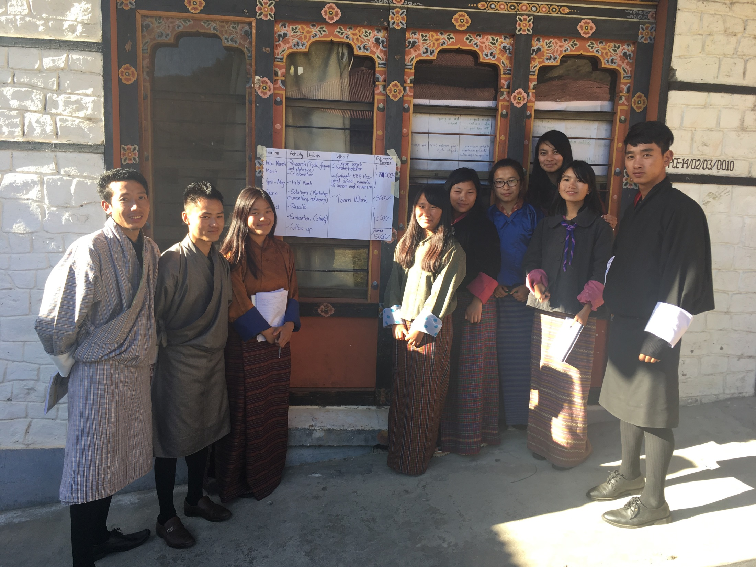
PITCHING PROJECTS

Slide 18
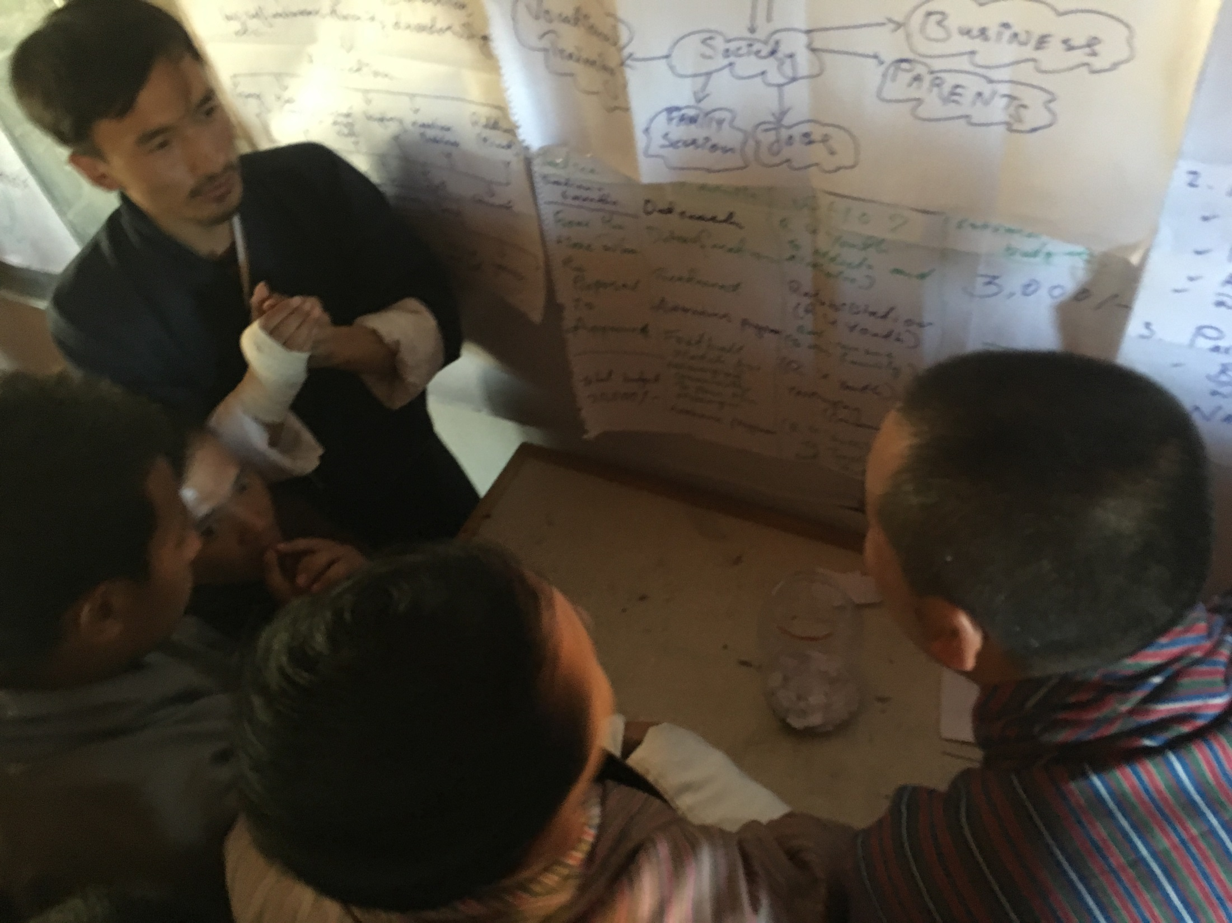
PITCHING PROJECTS

Slide 19
Further results - reflections
The training strengthened the Youth Initiative, Media clubs/media platforms and other youth groups – through enhancing the participants’ skills to lead social change
The training will reach broader – through building the capacity of participants to conduct step-down activities for other youth, including out-of-school and marginalized
The training planned ahead – through guiding participants to apply for seed funds to implement social initiatives in 2017

Slide 20
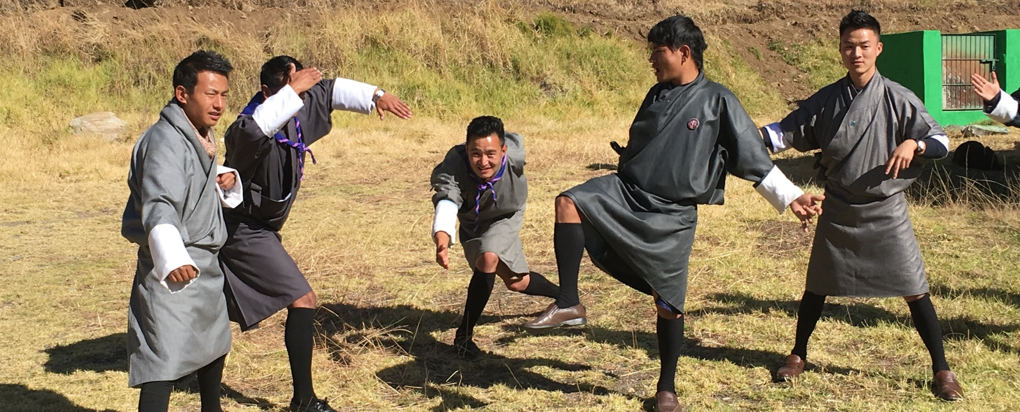
Next steps and follow-up
Youth groups to apply for seed-funds to project
Next youth leadership and multi-media training
Compilation of tools in to toolbox to be available online

Slide 21
THANK YOU FOR YOUR ATTENTION

